Slide 1


Economic Security for All : Thrive Cowlitz County
Economic Security for All
Group Planning Session
April 28, 2021

Slide 2

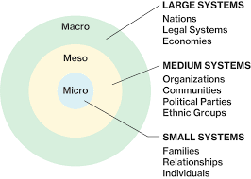

The Economic Security for All (EcSA) or Thrive initiative supports
a long-term, systemic approach to helping the individuals
living in Cowlitz County, Washington move out of poverty.
Thrive partners work together to do the following:
Support under-and unemployed individuals to find quality employment at 200% above the Federal Poverty Level
Expand community organizing capacity for the neighborhoods with the highest % of poverty
Advocate and collectivize for systemic change

Slide 3
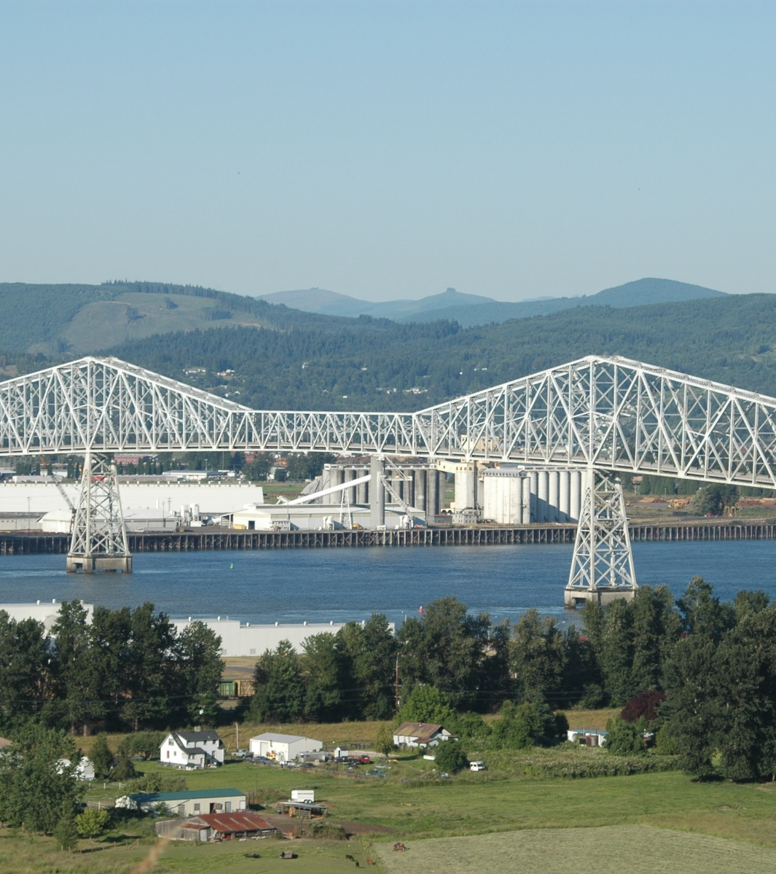
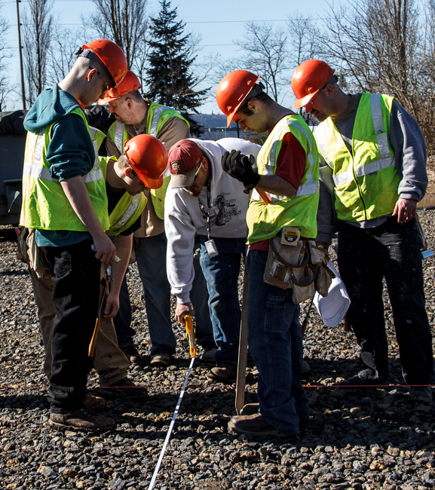
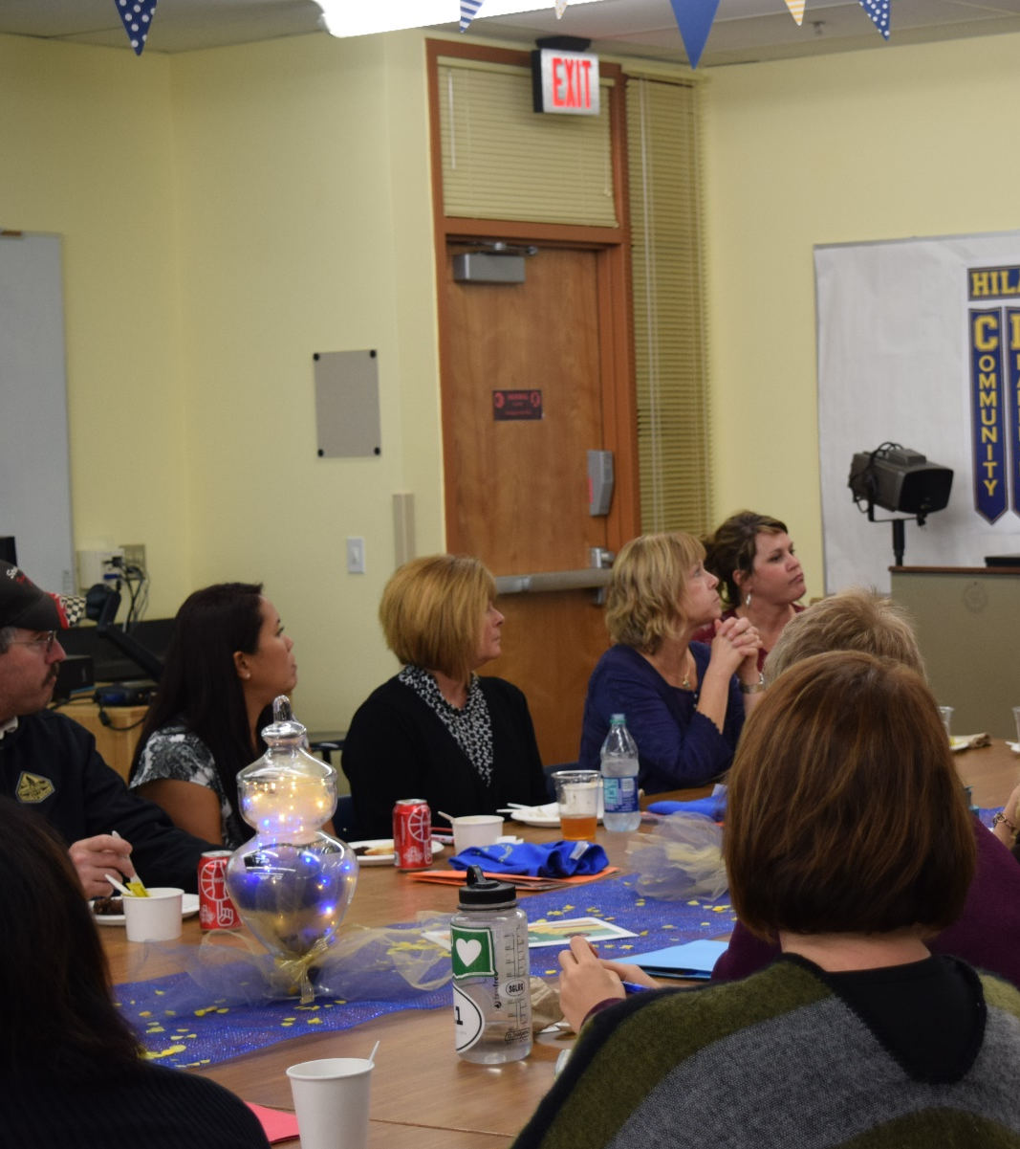
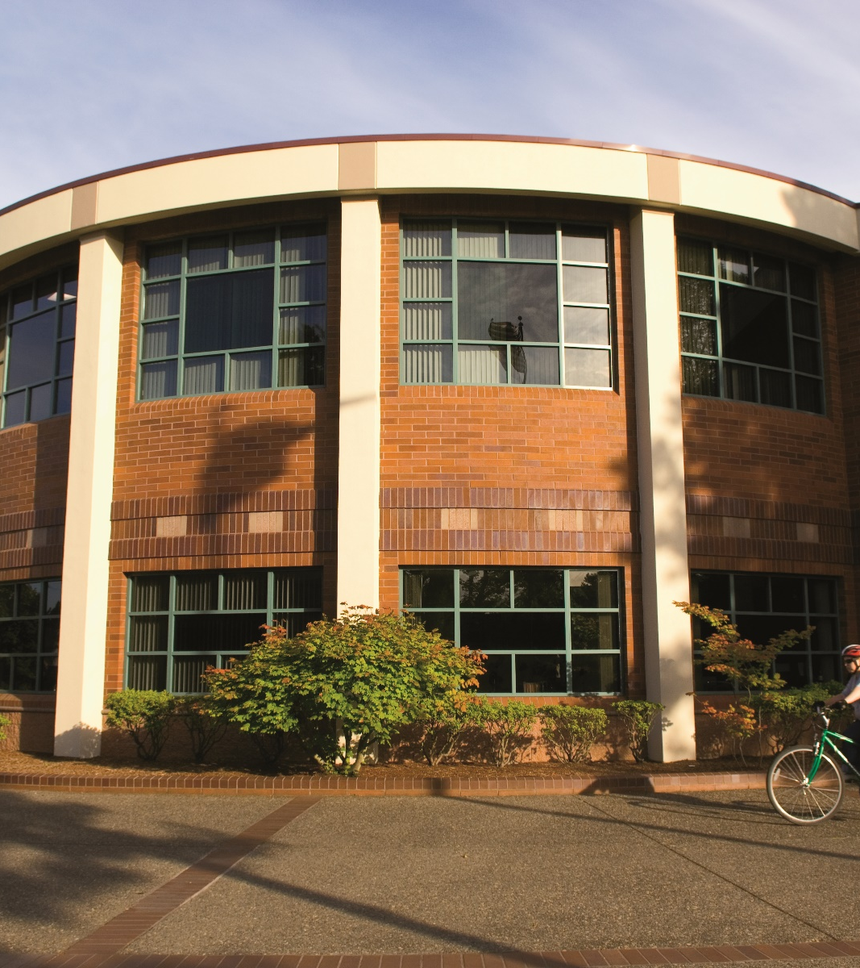

Economic Security for All – Thrive
Four Major Components
Engaging Industry + Investors
Outreach + Recruitment
Community Organizing
Structural Change
Business leadership provides opportunity for current employees to get assistance from the workforce system, and for the workforce system to provide support to business leadership in continuous improvement.
Through DSHS, WorkSource, and a variety of community-based organizations, engage and recruit jobseekers to enter pathways to employment above 200% FPL.
Habitat for Humanity is leading the effort in engaging neighborhood and community resources through the Neighborhood Resource Coordination Council.
WSW is working with local community leaders, Investors, and elected officials to determine structural changes that will improve neighborhoods and help keep people out of poverty.

Slide 4




Response to COVID-19
Technology Access – Internet, Computers
100% Virtual Workshops + Talent Development
Childcare Private-Public Model Development

Slide 5




Components in Progress
Common Referral System
Data Sharing Agreement
Developing a closed loop referral system to aid in participant referrals, retention and successful program exit across partners.
Data sharing agreement between WSW + DSHS to allow for focus on employment / reemployment connections via WDC programs.
Integration of Programs
Outreach Investment Strategy
Integrated service provision across BFET, Title 1, EcSA to increase capacity to serve.
Continuation of paid advertising consultant for WorkSource Kelso, and new grant opportunity for expanded population-specific outreach.

Slide 6
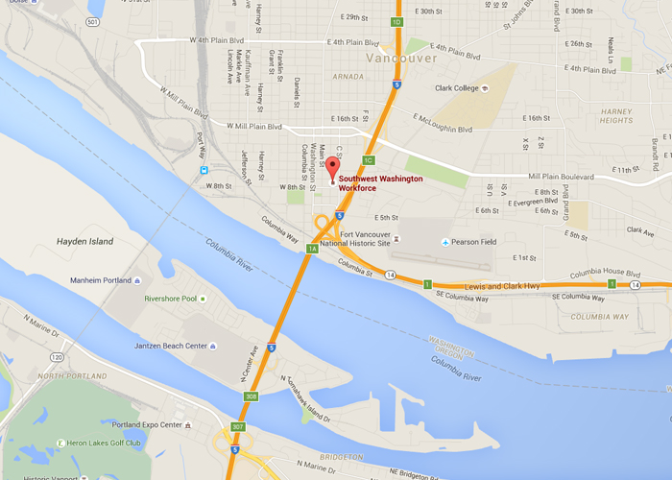
Contact Us
Phone: 360.567.3185
Email: mhalliday@workforcesw.org
Office: 805 Broadway, Suite 412, Vancouver, WA 98660
Online: www.workforcesw.org
Twitter: @WorkforceSWWA

