Slide 1


EcSA-Connell “Si Se Puede-Yes We Can” Model & Adaptations
Jamilet Nerell
Community Programs Manager

Slide 2

Model Demographics
WorkSource Columbia Basin (WSCB)
2 FTE Case Managers
Bilingual (English/Spanish)
Area of Service: City of Connell
45 minutes, by car, north of WSCB
Rural community
Lack of near-by employment and training resources
Single Latina mothers living in poverty
Asset, Limited, Income, Constrained, Employed (ALICE) United Way Research

Slide 3
EcSA-Connell Program Model
Four Pillars of Support
Increase the availability of employment, training, and essential supportive services to unstable households, in North Franklin County – City of Connell.
Transportation: Expand drop off zones and routes times, partner People for People, shuttle from-and-to rural areas.
Healthcare: Create a system of referrals, with Lourdes Health, Medical and Counseling Care Centers and connect participants to affordable healthcare programs.
Childcare: Create employment opportunities, with Childcare Aware and the Imagine Institute of WA, for in-home childcare opportunities for entrepreneurship, mentorship, and connect to local childcare providers for limited-income families.
Employment & Training: In-demand occupational trainings and employment placements for self-sufficient wages; encourage co-enrollment exploration with system partners.

Slide 4
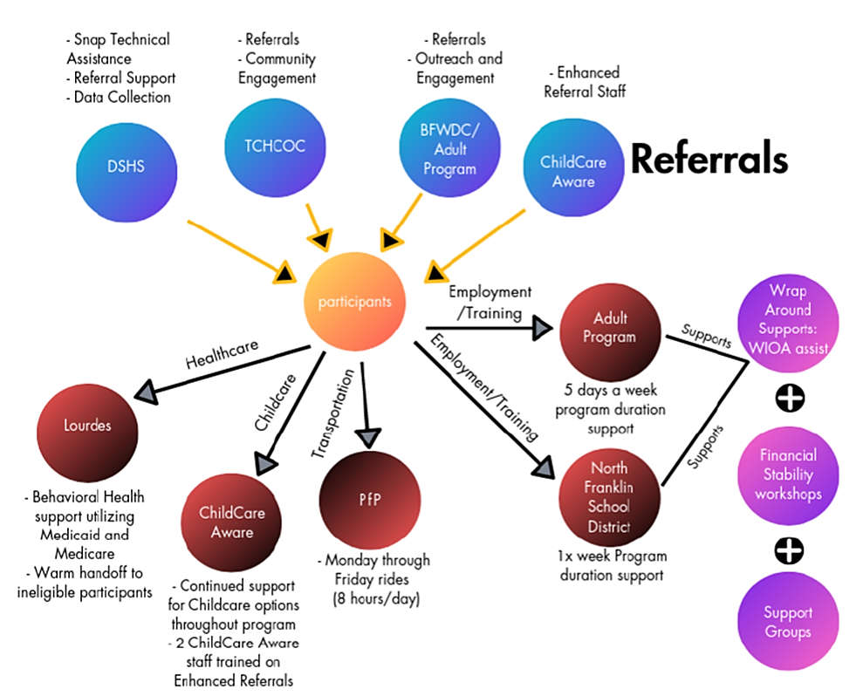

Logic Model: Partnerships & Roles

Slide 5

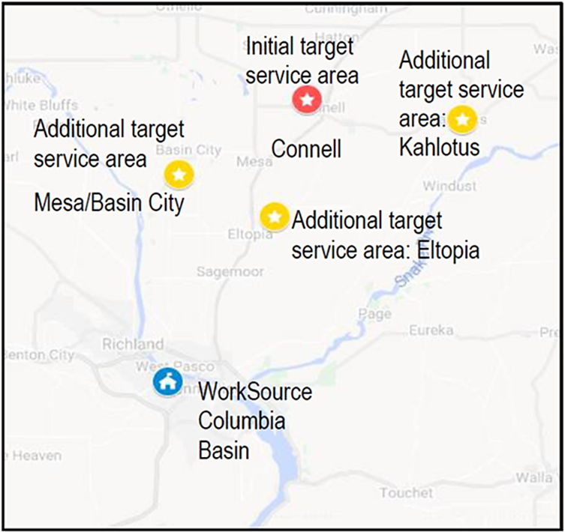
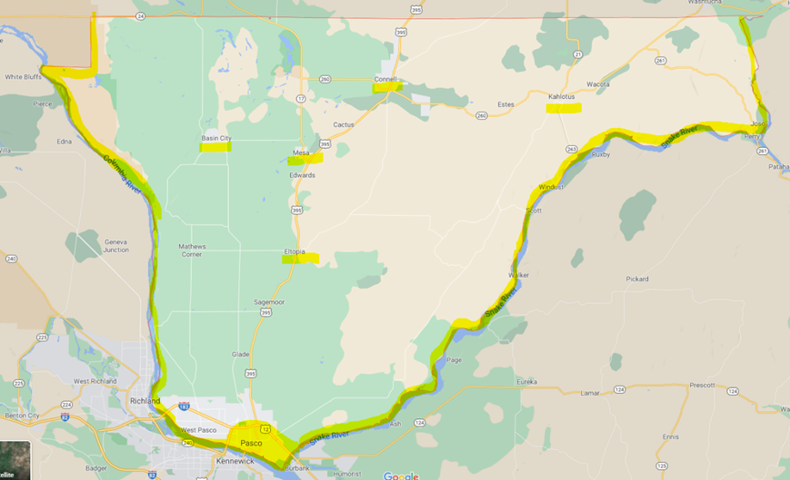
COVID Environment Adaptation: Area of Service Expansion
Franklin County Map

Slide 6
COVID Environment Adaptation: Service Delivery
Expanded Area of service to all Franklin County
Continue serving a percentage of participants from North Franklin County/City of Connell.
Removal of Supplemental Nutrition Assistance Program (SNAP) enrollment eligibility
SNAP is a public charge associated with immigration and naturalization process.
Continued partnership with DSHS
Targeted outreach via cold calls and program flyer mailing.
Increased partnerships connections with community agencies serving unstable households in Franklin County
Additional connections to expand referral system and connect to services EcSA does not provide.
Modified Assessment and Career Planning Requirements
Removed the requirement of Mentorship (one-on-one and group mentorship), Financial Literacy, and Self-Sufficient Matrix Assessments; offer those services as needed basis.

Slide 7
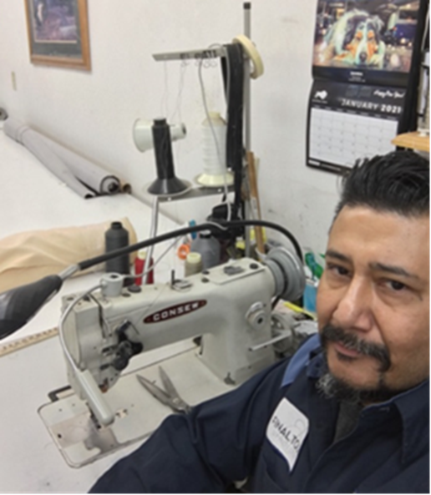
Participant Success Story
The holidays were approaching, and Christopher had a growing concern about how he would make it through the rest of the year without a job or a stable place to call home. He was discouraged by the challenges he faced, including his former incarceration. Christopher knew his past mistakes would always be there and would impact his ability to connect to employment. He was losing hope. A few weeks passed by, and Chris had run into an old acquaintance, Jon. Jon ran a successful upholstery business and had an abundance of projects. Jon was aware of Chris’ upholstery skills and offered him an opportunity to work from home repairing damaged furniture pieces. Chris was excited about the prospect of this opportunity but was unsure how he could afford to set up a shop with the necessary tools and equipment to do this piecework. Chris’s significant other had previous experience with the America’s Job Center, WorkSource Columbia Basin. She encouraged him to reach out, and he did. Unfortunately, due to the COVID-19 outbreak and Shelter in Place order, the offices were closed. Chris didn’t give up; he found contact information and connected with an Employment Specialist to inquire about financial assistance to set up shop with this new opportunity. The Employment Specialist who worked with Chris conducted an assessment and determined that he was eligible for assistance in reaching his self-employment goal. There were two programs he would benefit from Workforce Innovation and Opportunity Act-Title 1 Adult and Economic Security for All. Through those programs, he received coaching, mentoring, and supportive services as he worked on his employment goals. Chris received funding that provided the necessary equipment to set up a home upholstery workshop. During a support service outing searching for additional materials, Chris befriended the hiring manager from Final Touch Upholstery, a local material shop. After their pleasant encounter, the hiring manager was impressed with Chris’ upholstery repair talents and determination. He offered Chris a full-time job with medical benefits repairing large items for their shop. Chris had secured two positions with excellent starting wages within a few weeks. One as an independent contractor earning $150-$300 per job and the other with Final Touch Upholstery earning $21 per hour. Chris has now been working for five weeks and has had the opportunity to rebuild his life. He is beginning to save money to repair his Cadillac, has a stable home, provides for himself, and is happy to have found a meaningful career.

Slide 8

Q&A Thank you!
Contact Information
E-mail: Jnerell@bf-wdc.org
Phone: 509-440-9831

