Slide 1
EcSA Group Planning Session 1 April 28, 2021
Washington State
Accountable Communities of Health

Slide 2
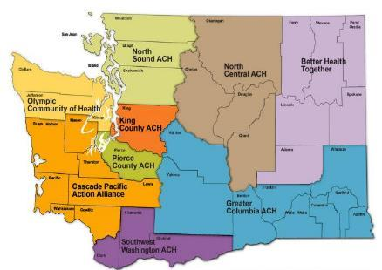
Washington’s Accountable Communities of Health (ACH)
Regional organizations that improve health with community partners:
Convene activities that improve population health outcomes
Support health equity and marginalized groups
Deliver on infrastructure
Notes:
Independent regional organizations that work with community partners on health needs and priorities
Some are LLCs, some are nonprofit organizations
All are fully functioning legal entities
Borders are aligned with Medicaid purchasing regions
Critical support for integrated managed care

Slide 3
ACH Leadership
Alison Poulsen, alison@betterhealthtogether.org - Better Health Together
Jean Clark, clarkj@crhn.org – Cascade Pacific Action Alliance
Alisha Fehrenbacher, alisha@elevatehealth.org - Elevate Health
Carol Moser, cmoser@greatercolumbiaach.org - Greater Columbia ACH
Susan McLaughlin, smclaughlin@healthierhere.org - HealthierHere
Linda Parlette, Linda.Parlette@cdhd.wa.gov - North Central ACH
Liz Baxter, liz@northsoundach.org - North Sound ACH
Celeste Schoenthaler, celeste@olympicch.org - Olympic Community Health
Eric McNair Scott, eric.scott@southwestach.org - Southwest WA Accountable Community of Health

Slide 4
Pandemic: ACH Response
Telehealth
Food
Masks

Slide 5
Traditional: ACH Results
Opioid crisis response
Whole person care implementation
Workforce development, diversion from emergency room, community-based care coordination…list goes on.

Slide 6
Opportunity
Community Information Exchange

Slide 7
Discussion
More Information:
https://www.hca.wa.gov/ach
Michael Arnis
Deputy Policy Director
Washington State Health Care Authority
michael.arnis@hca.wa.gov

