Slide 1

Washington State Continuum of Care (CoC) Balance of State (BoS)
A Brief Explainer
Mark Porter
BoS CoC Program Manager, Collaborative applicant
April 2021

Slide 3
Slide Deck Goals
What is the Continuum of Care (CoC)
Where are Washington State CoC’s?
What Do We Do? (Commerce and Steering Committee)
Funding Across the State
CoC Annual HUD Competition Facts
What kinds of Housing is Provided
And…..
How does All of this Intersect with Job Creation and Retention?

Slide 4
What is a Continuum of Care?
Continuum’s of Care (CoCs) are coalitions of organizations dedi cated to ending homelessness.
There are 6 CoCs in Washington State – and over 400 CoCs across the U.S. and its territories. (17,800 state folks helped annually)
The Department of Commerce is the Collaborative Applicant for the Washington Balance of State Continuum of Care (BoS CoC). The BoS CoC’s 34 small and medium-sized counties receive about $12 million annually for almost 60 permanent and temporary housing projects funded by HUD.

Slide 5
What Kinds of BoS CoC Services/Housing?
Permanent Supportive Housing (PSH) – Community-based housing without a designated length of stay for persons with disabilities.
Rapid Re-Housing – Emphasizes housing search and relocation services and short and medium term rental assistance to move homeless persons and families into permanent housing.
Transitional Housing – Designed to help homeless persons and families with interim stability and support to move to and maintain permanent housing and lasts 24 months.
Supportive Services Only – Used for outreach to help serve homeless persons not living in housing operated by a grantee to help them with other services and support.

Slide 6
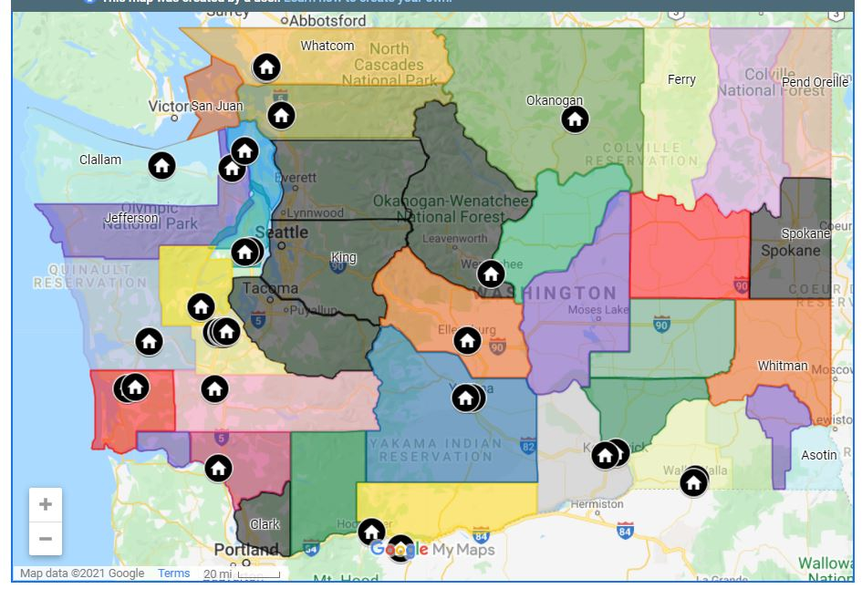
Where are BoS CoCs Located?

Slide 7
What the heck do we do?
Develop and apply long-term plans to prevent and end homelessness
Submit a consolidated, competitive application to the annual (Notice of Funding Availability) NOFA competition
Help establish a Homeless Management Information System (HMIS) for the CoC
Report on homelessness through the annual Point in Time Count, (PIT) the Housing Inventory Chart and Annual Performance Review

Slide 8
How much money are we talking about?

Slide 9
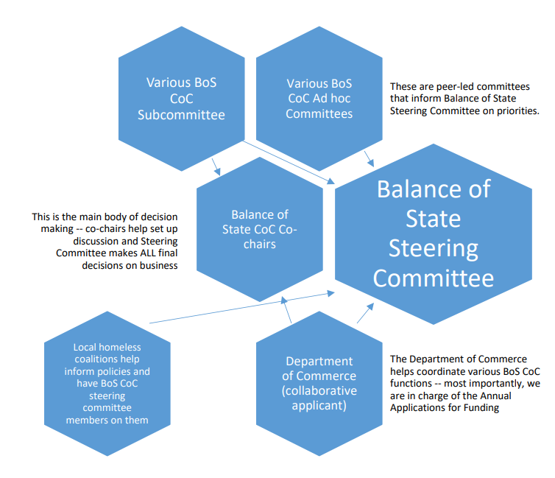
Who are decision makers? Here it Goes!

Slide 10
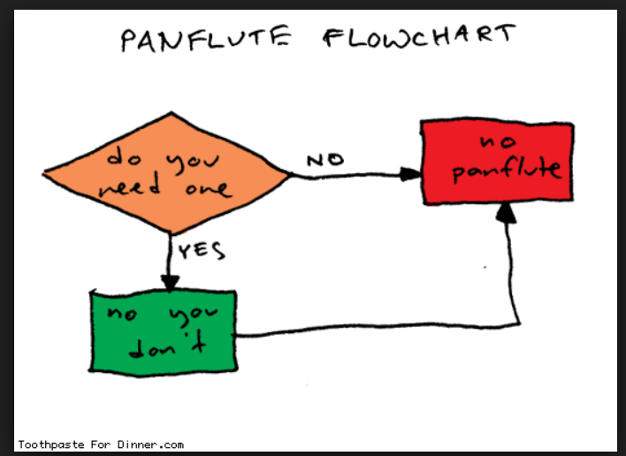
Because you endured the last chart -- here is the greatest flow chart!

Slide 11
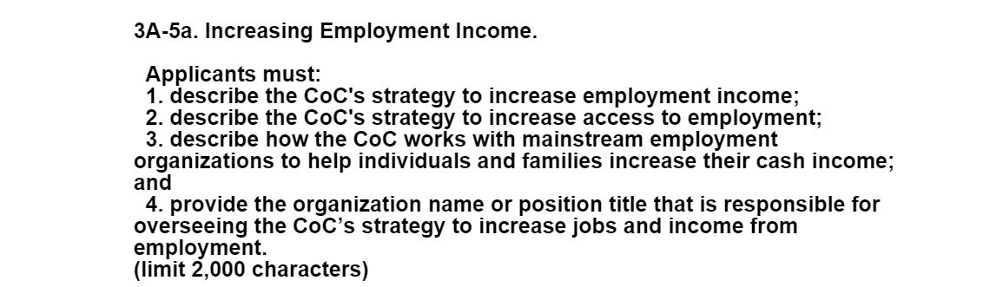
OK, what does this have to do with jobs?
Annual NOFA!

Slide 12
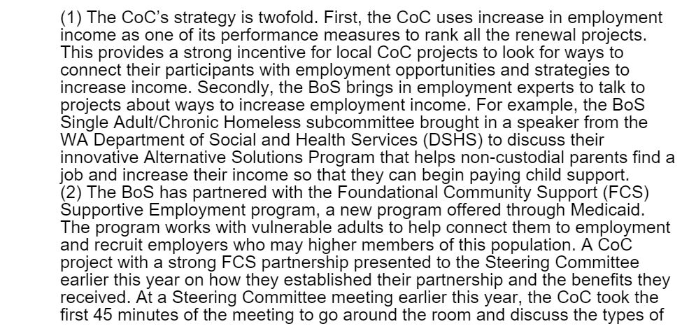
OK, what does this have to do with jobs?
Annual NOFA!

Slide 13
And the better we do on the annual NOFA…
The more money we get to help those in need!
I have given John a contact list and he can send it out with meeting notes – it is just a list of people who can probably help you or connect you to right folks.
Please email me at mark.porter@commerce.wa.gov if you don’t have a good contact in your community for homeless or housing (usually a community action agency)

Slide 14
Thank you!
Mark Porter
Program Manager
Mark.porter@commerce.wa.gov
360-

