Slide 1


Expanding Access to Homeownership

Slide 2

Since 1995, WHRC has helped
OVER 140,000
Washington homeowners to achieve the dream of homeownership or avoid foreclosure.
©2025 Washington Homeownership Resource Center
©2025 Washington Homeownership Resource Center

Slide 3
As a 501(c)3 organization, we are community-supported and financed through government grants, corporate philanthropic contributions, and individual donations. This support allows us to provide unbiased, free information and referrals. We are Washington state’s official homeownership hub.
©2025 Washington Homeownership Resource Center
©2025 Washington Homeownership Resource Center

Slide 4

OUR MISSION

Slide 5

The mission of the Washington Homeownership Resource Center (WHRC) is to preserve and increase homeownership in Washington state by educating and empowering current and future homeowners.

Slide 6

OUR WORK
‹#›

Slide 7


Through our hotline & website we provide our clients with personalized information and referral to vetted homeownership supports, including:
Homebuyer assistance programs
Pre-purchase education and counseling
Mortgage, property tax, and HOA foreclosure intervention counseling
Reverse mortgage counseling
Owner-occupied repair assistance
Post-purchase education and assistance
Lending and Real Estate professionals
Legal aid
Credit counseling

Slide 8

WHRC is a proud partner of the Black Home Initiative!
The goal of the Black Home Initiative (BHI) is to create opportunity
for 1,500
low-and moderate-
income Black households to own a home in South Seattle, South King County, Thurston County, and North Pierce County within the next seven years.
©2025 Washington Homeownership Resource Center
©2025 Washington Homeownership Resource Center

Slide 9
WHAT IS A FIRST-TIME HOMEBUYER?​

Slide 10
You have not owned a home within the past three years​
You are a single parent who has only owned a home while married to a former spouse.​
You have only owned a residence that had no permanent foundation (such as a manufactured home)​
You only owned a property that was determined to be uninhabitable.​
©2025 Washington Homeownership Resource Center

Slide 11
A HOMEBUYER’S JOURNEY

Slide 12
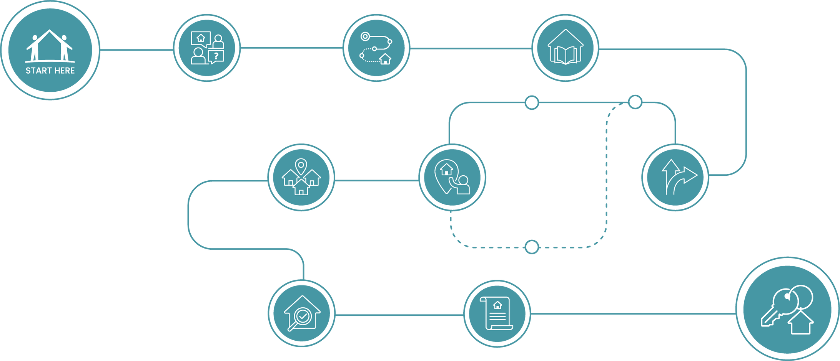
OVERVIEW
Homebuyer’s Journey Map
Notes:
3

Slide 13
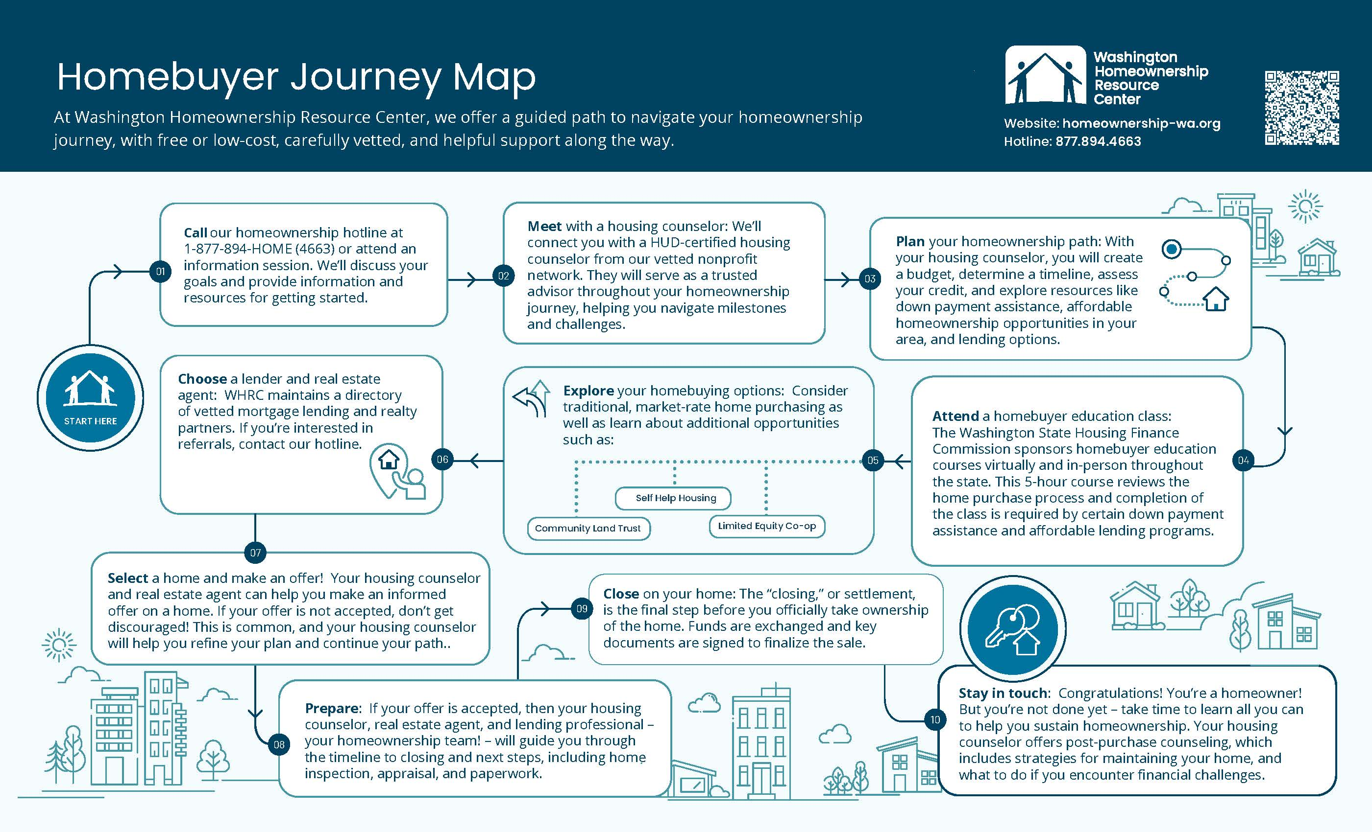
Notes:
3

Slide 14


STEP 01
Call our Hotline or attend
a Homebuyer Info Session
We’ll discuss your goals and provide information and resources for getting started. The WHRC hotline is
1-877-894-HOME (4663).
Notes:
11

Slide 15


STEP 02
Meet with a Housing Counselor
We will connect you with a HUD-certified housing counselor from our verified non-profit network. They will serve as a trusted advisor throughout your homeownership journey, helping you navigate milestones and challenges.

Slide 16


STEP 03
Plan your homeownership path
With your housing counselor, you will create a budget, determine a timeline, assess your credit, and explore resources like down payment assistance, affordable homeownership opportunities in your area, and lending options.

Slide 17


Covenant Homeownership Program
Deep roots in Washington?
WHRC collaborates closely with WSHFC and the new Covenant Homeownership Program. This program provides assistance with the down payment on a home for families who were impacted by state-sanctioned housing discrimination before 1968.
Program eligibilty & details:
Household income at or below 120% of the Area Median Income (AMI)
First-time homebuyer
The homebuyer (or a parent, grandparent, or great-grandparent of the homebuyer) lived in Washington state before April 1968
20% DPA up to 150k + closing cost
The person who lived in Washington before April 1968 is Black, Hispanic, Native American/Alaska Native, Native Hawaiian or other Pacific Islander*, Korean or Asian Indian
*Following the U.S. Census definitions, “Pacific Islander” includes individuals with origins in any of the original peoples of Hawaii, Guam, Samoa, or other Pacific Islands, including, for example, Samoan, Chamorro, Tongan, Fijian, and Marshallese.

Slide 18


STEP 04
Attend a homebuyer education class
The Washington State Housing Finance Commission sponsors homebuyer education courses virtually and in-person throughout the state. This 5-hour course reviews the home purchase process and completion of the class is required by certain down payment assistance and affordable lending programs.

Slide 19


STEP 05
Explore your homebuying options
Consider traditional, market-rate home purchasing as well as learn about additional opportunities such as:
• Community Land Trust
• Self Help Housing
• Shared Co-op

Slide 20


STEP 06
Choose a lender and
real estate agent
WHRC maintains a directory of vetted mortgage lending and real estate partners. If you’re interested in referrals, contact our hotline.

Slide 21


STEP 08
Prepare
If your offer is accepted, then your housing counselor, real estate agent, and lending professional – your homeownership team! – will guide you through the timeline to closing and next steps, including home inspection, appraisal, and paperwork.

Slide 22


STEP 09
Close on your home
The “closing,” or settlement, is the final step before your officially take ownership of the home. Funds are exchanged and key documents are signed to finalize the sale.

Slide 23


STEP 10
Congratulations, you’re
a homeowner!
But you’re not done yet – take time to learn all you can to help you sustain homeownership. Your housing counselor offers post-purchase counseling, which includes strategies for maintaining your home, and what to do if you encounter financial challenges.
20

Slide 24
Q & A
Hotline: 1-877-894-HOME (4663)
Website: homeownership-wa.org

